Slide 1


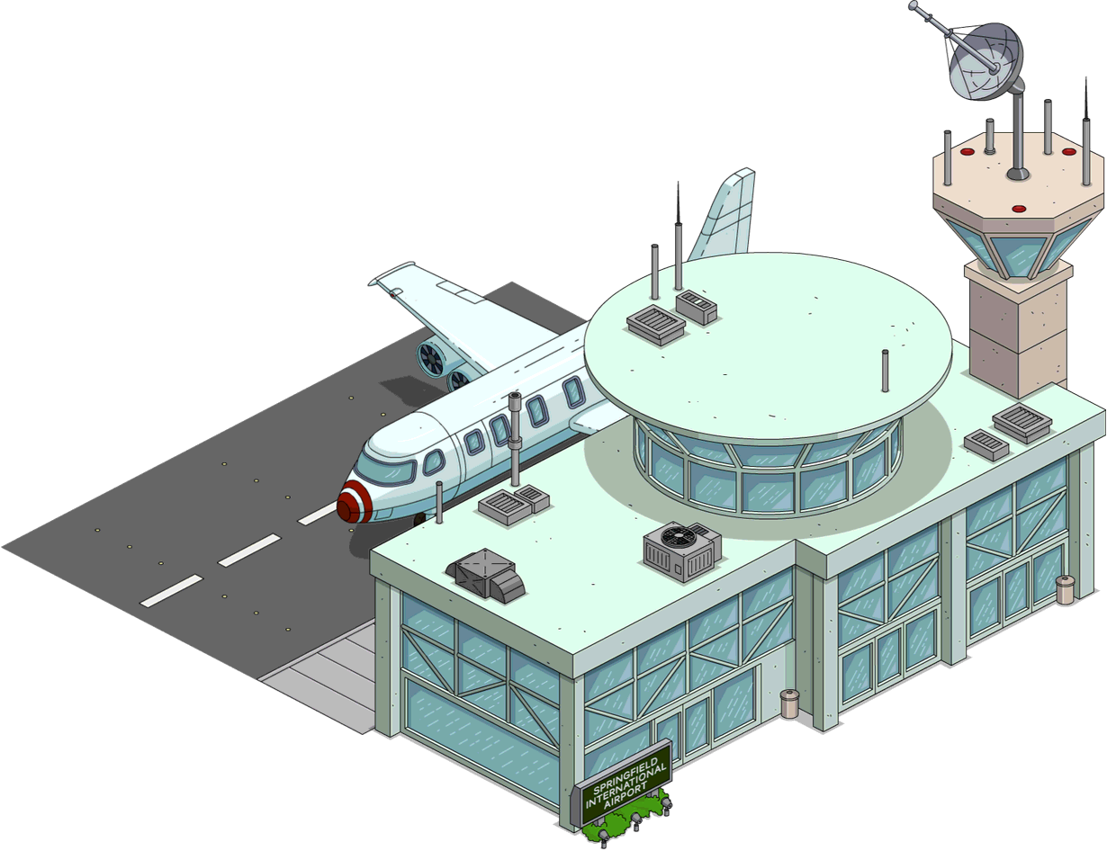






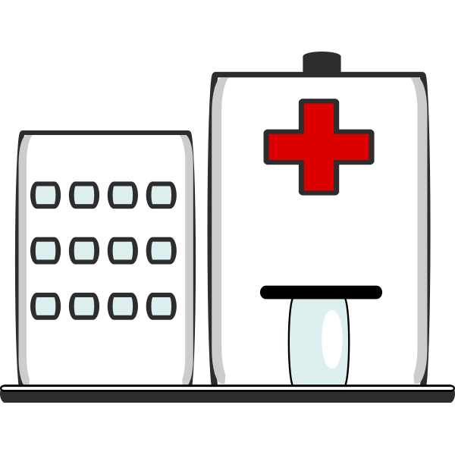

Kelulusan JKN Sarawak
Kelulusan PDRM merentas negeri
PCR Test Result (72 hours)
Return Ticket (short stay only)
EnterSarawak
Counter APM
Register PUS details
STP System powered by TracAPM
QS Booking
E-Health
Counter KKM
Get quarantine order
Counter JIM
Immigration
Traveller/PUS
Quarantine Station
Check in QS
Transport
Private transportation
TracAPM System & DB
SIMKA
STP System powered by TracAPM
Transport Management System powered by TracAPM
Ruang Menunggu
PUS arranged according to QS
Transport Management System powered by TracAPM
Lab System
Home Quarantine
Check in QS
Transport
Waiting for transportation
PUS PCR Test
SafeTrac
powered by TracAPM

Slide 2
SARAWAK Quarantine Management Flow
Kaunter APM
Register PUS details
Kaunter KKM
Get quarantine order
Kaunter JIM
Imigresen
Ruang Menunggu
PUS disusun mengikut QS
No | Check List To Enter Sarawak
1 | Kelulusan JKN Sarawak
2 | Kebenaran Merentas Negeri (PDRM)
3 | PCR Test (72 hours before arrival)
4 | Return Ticket (for short stay)
Transport
Kenderaan lain
Transport
Waiting for transportation
QS
Check in QS

